Slide 1
Monday, October 24, 2016
Write In Your Agenda:
Write In Your Monitoring Log:
CW:
Earthquake PPT and notes
Earthquake Crossword and Word Search
HW:
None.
Response to Warm-Up:
Have you ever experienced an earthquake? If so, what was it like?
You will need:
Pencil
New Monitoring Log (green)

Slide 2
Monday, October 24, 2016
Work with a partner.
Go to http://www.cusd80.com/Page/76352
Complete Earthquake Power Point note sheet.
Hand in when finished.
Work on Earthquake Crossword and Word Search. Use the power point to help you.

Slide 3
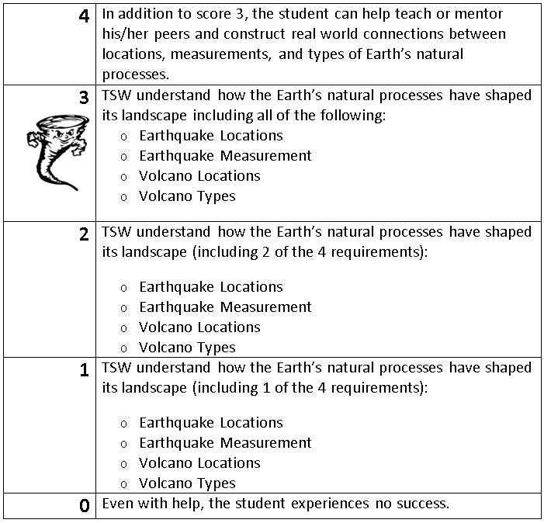
Learning Goal and Scale
TSW understand how the Earth’s natural processes have shaped its landscape (including Earthquake locations and how they are measured as well as Volcano locations and the three types).

